Slide 1
敬拜主Majesty
敬拜主，敬拜全能的主
Majesty, worship His majesty
榮耀能力，一切讚美都歸給祂
Unto Jesus be all glory, power and praise
敬拜主，敬拜權柄的主
Majesty, Kingdom authority
從祂寶座，能力流出，流到萬民
Flow from His throne unto His own,
His anthem raise

Slide 2
※來高舉，一同高舉，主耶穌聖名
So exalt, lift up on high the name of jesus
來彰顯，一同彰顯，耶穌榮耀王
Magnify, come glorify Christ Jesus,the King
敬拜主，敬拜尊貴的主
Majesty, worship His majesty
祂曾捨命，今得榮耀，萬王之王
Jesus, who died, now glorified, King of all King.

Slide 3
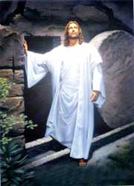
因祂活著 Because He Lives
神差愛子，人稱祂耶穌
God sent His Son, they called him Jesus
祂賜下愛，醫治寬恕
He came to love, heal and forgive
死裏復活，使我得自由
He lived and died to buy my pardon,
那空墳墓就是我的得救記號
An empty grave is there to prove my Savior Lives.

Slide 4
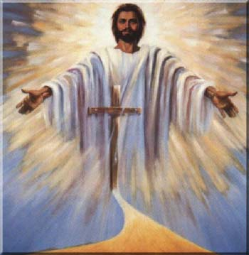
因祂活著，我能面對明天
Because He lives I can face tomorrow
因祂活著，不再懼怕
Because He lives all fear is gone
我深知道，祂掌管明天
Because I know He holds the future
生命充滿了希望，只因祂活著
And life is worth the living just because He lives.

Slide 5
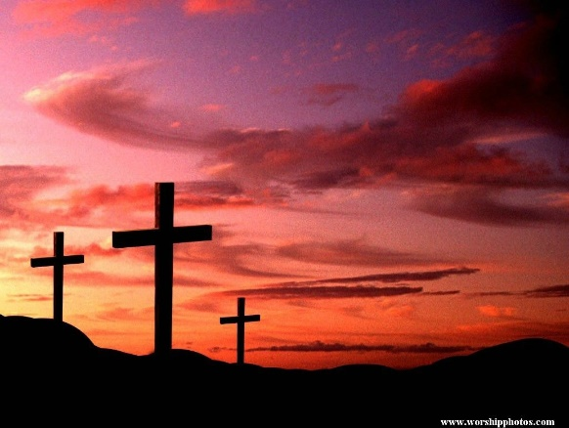
祂是主 He is Lord
祂是主，祂是主
He is Lord, He is Lord
祂是從死裏復活的救世主
He is risen from the dead, and He is Lord
萬膝要跪拜，萬口要頌揚
Every knee shall bow, Every tongue confess
耶穌基督是主
That Jesus Christ is Lord

